Slide 1
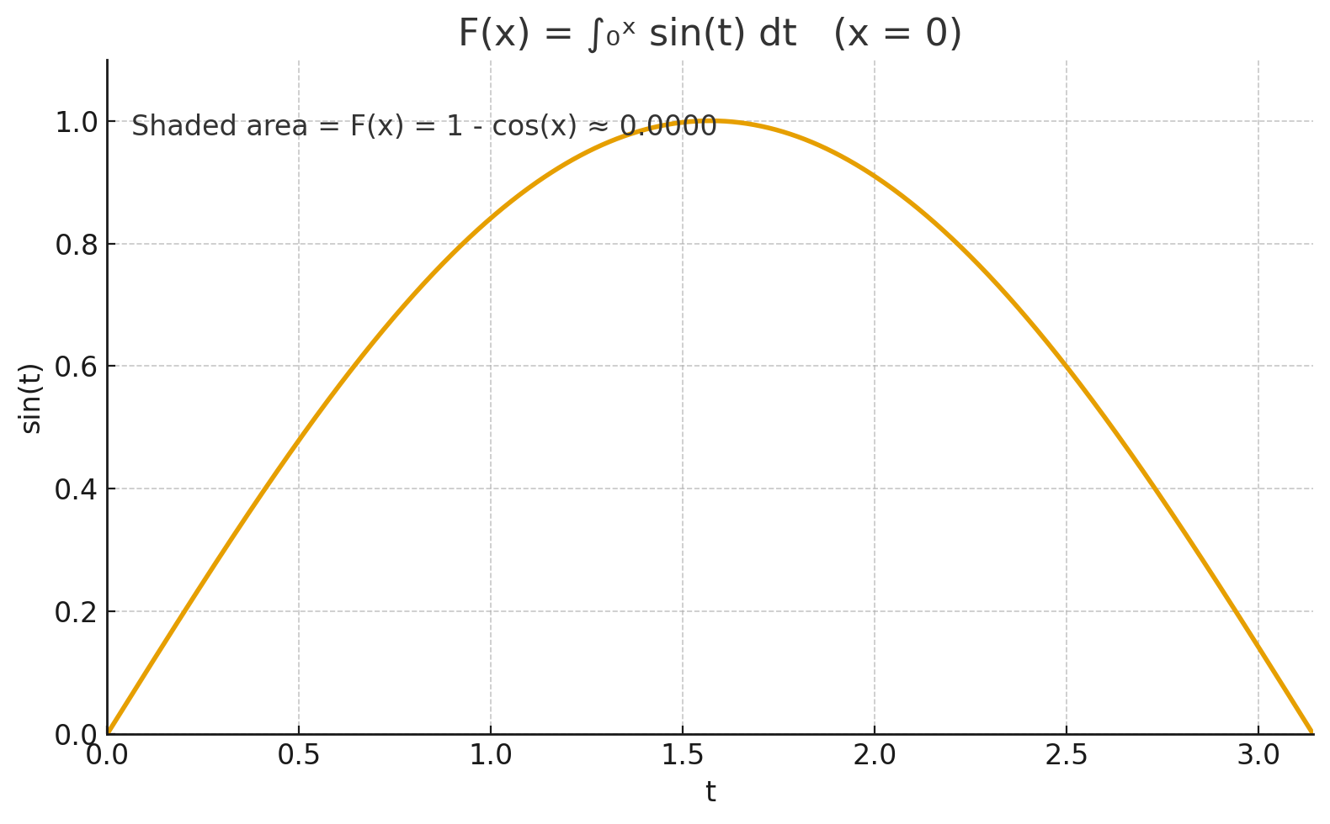
Integral Function: F(x) = ∫₀ˣ sin(t) dt — x = 0
• f(t) = sin(t) • F(x) accumulates the area under sin(t) from t = 0 up to t = x. • Here, F(x) = 1 - cos(x). • At x = 0: F(x) ≈ 0.0000.

Slide 2
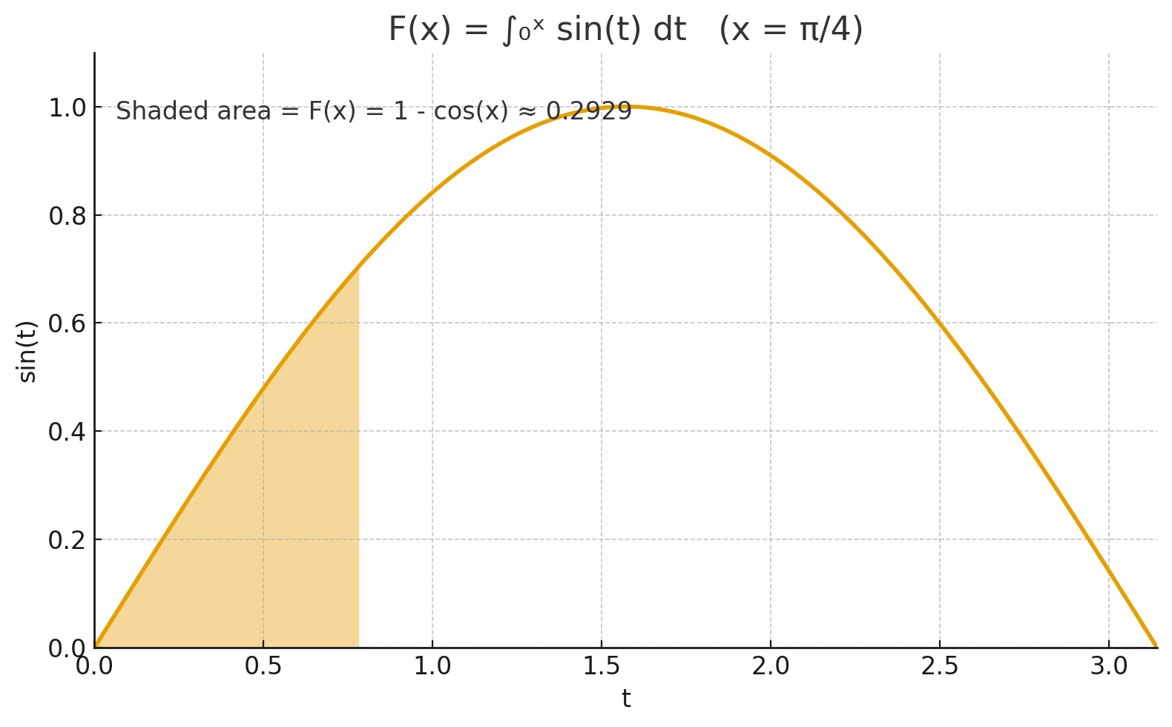
Integral Function: F(x) = ∫₀ˣ sin(t) dt — x = π/4
• f(t) = sin(t) • F(x) accumulates the area under sin(t) from t = 0 up to t = x. • Here, F(x) = 1 - cos(x). • At x = π/4: F(x) ≈ 0.2929.

Slide 3
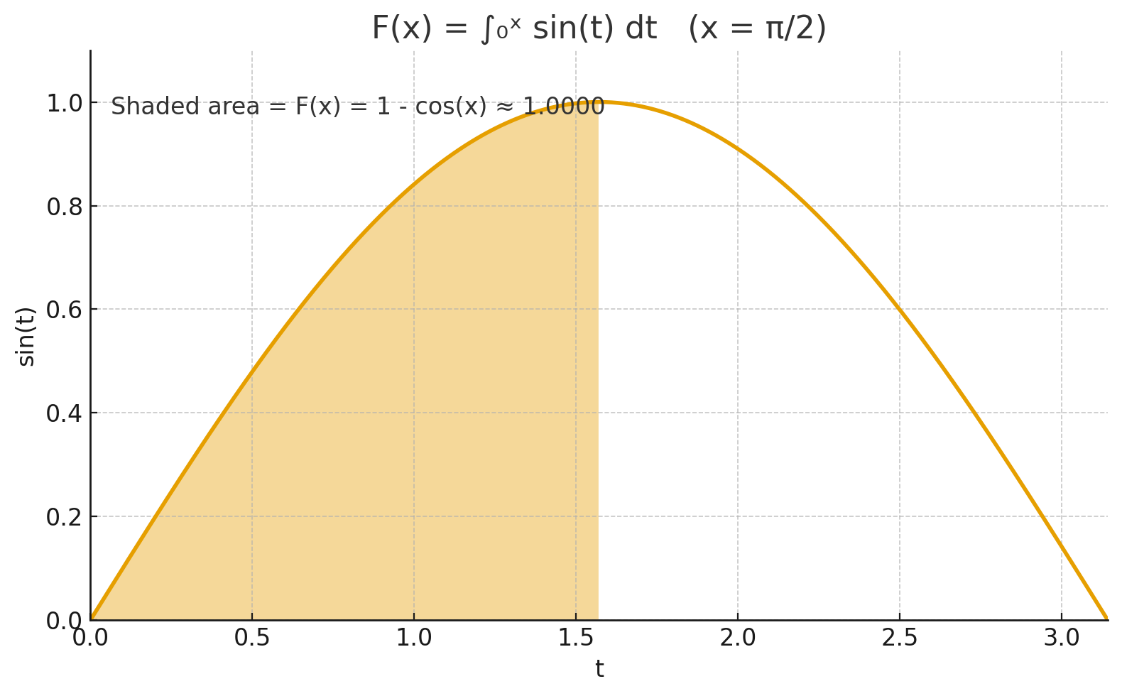
Integral Function: F(x) = ∫₀ˣ sin(t) dt — x = π/2
• f(t) = sin(t) • F(x) accumulates the area under sin(t) from t = 0 up to t = x. • Here, F(x) = 1 - cos(x). • At x = π/2: F(x) ≈ 1.0000.

Slide 4
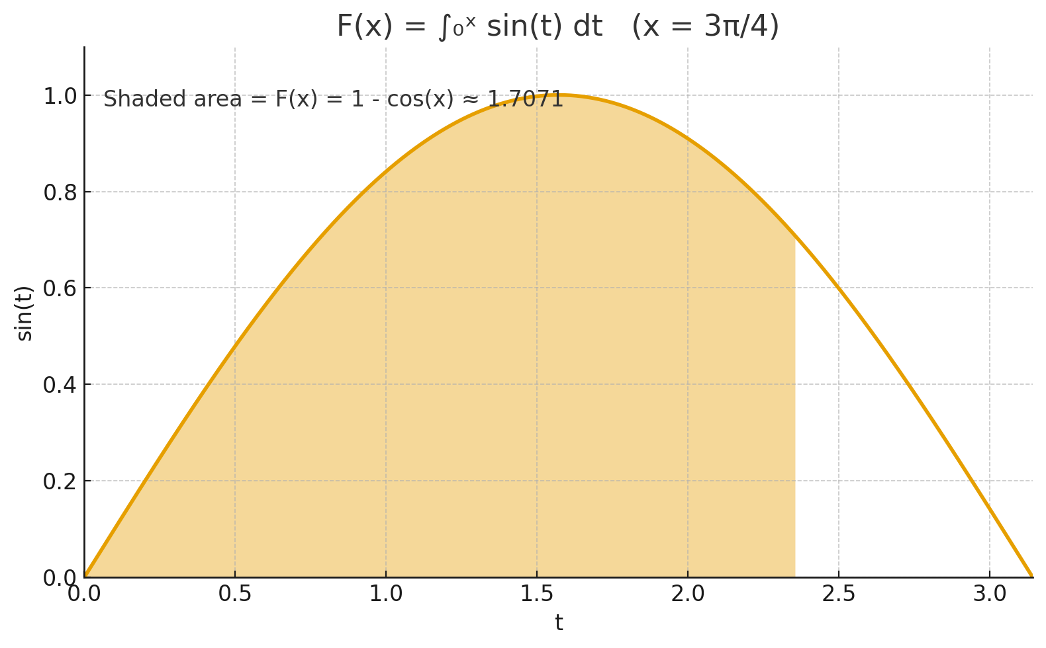
Integral Function: F(x) = ∫₀ˣ sin(t) dt — x = 3π/4
• f(t) = sin(t) • F(x) accumulates the area under sin(t) from t = 0 up to t = x. • Here, F(x) = 1 - cos(x). • At x = 3π/4: F(x) ≈ 1.7071.

Slide 5
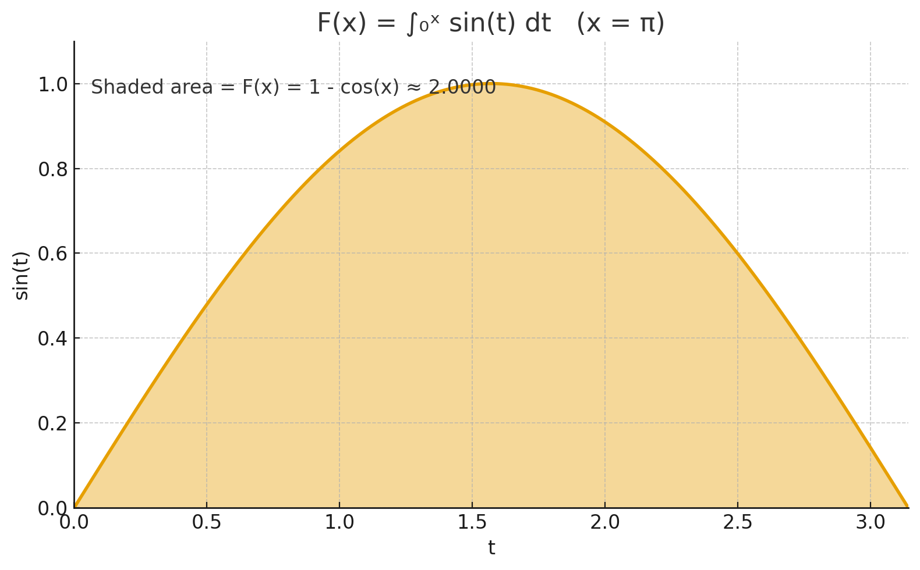
Integral Function: F(x) = ∫₀ˣ sin(t) dt — x = π
• f(t) = sin(t) • F(x) accumulates the area under sin(t) from t = 0 up to t = x. • Here, F(x) = 1 - cos(x). • At x = π: F(x) ≈ 2.0000.

